Slide 1
Wednesday, March 16th, 2022

Slide 2
OMNI CMS - Calendar Deep Dive
Deepika Chhabra, Product Manager
dchhabra@moderncampus.com

Slide 3
Agenda
Calendar Overview
Deep Dive
Enable Calendar
Setup Calendar
Add Calendar
Create & Publish Events
Event Actions
Dashboard Overview
Embed Calendar
ICS Feeds
Q&A

Slide 4
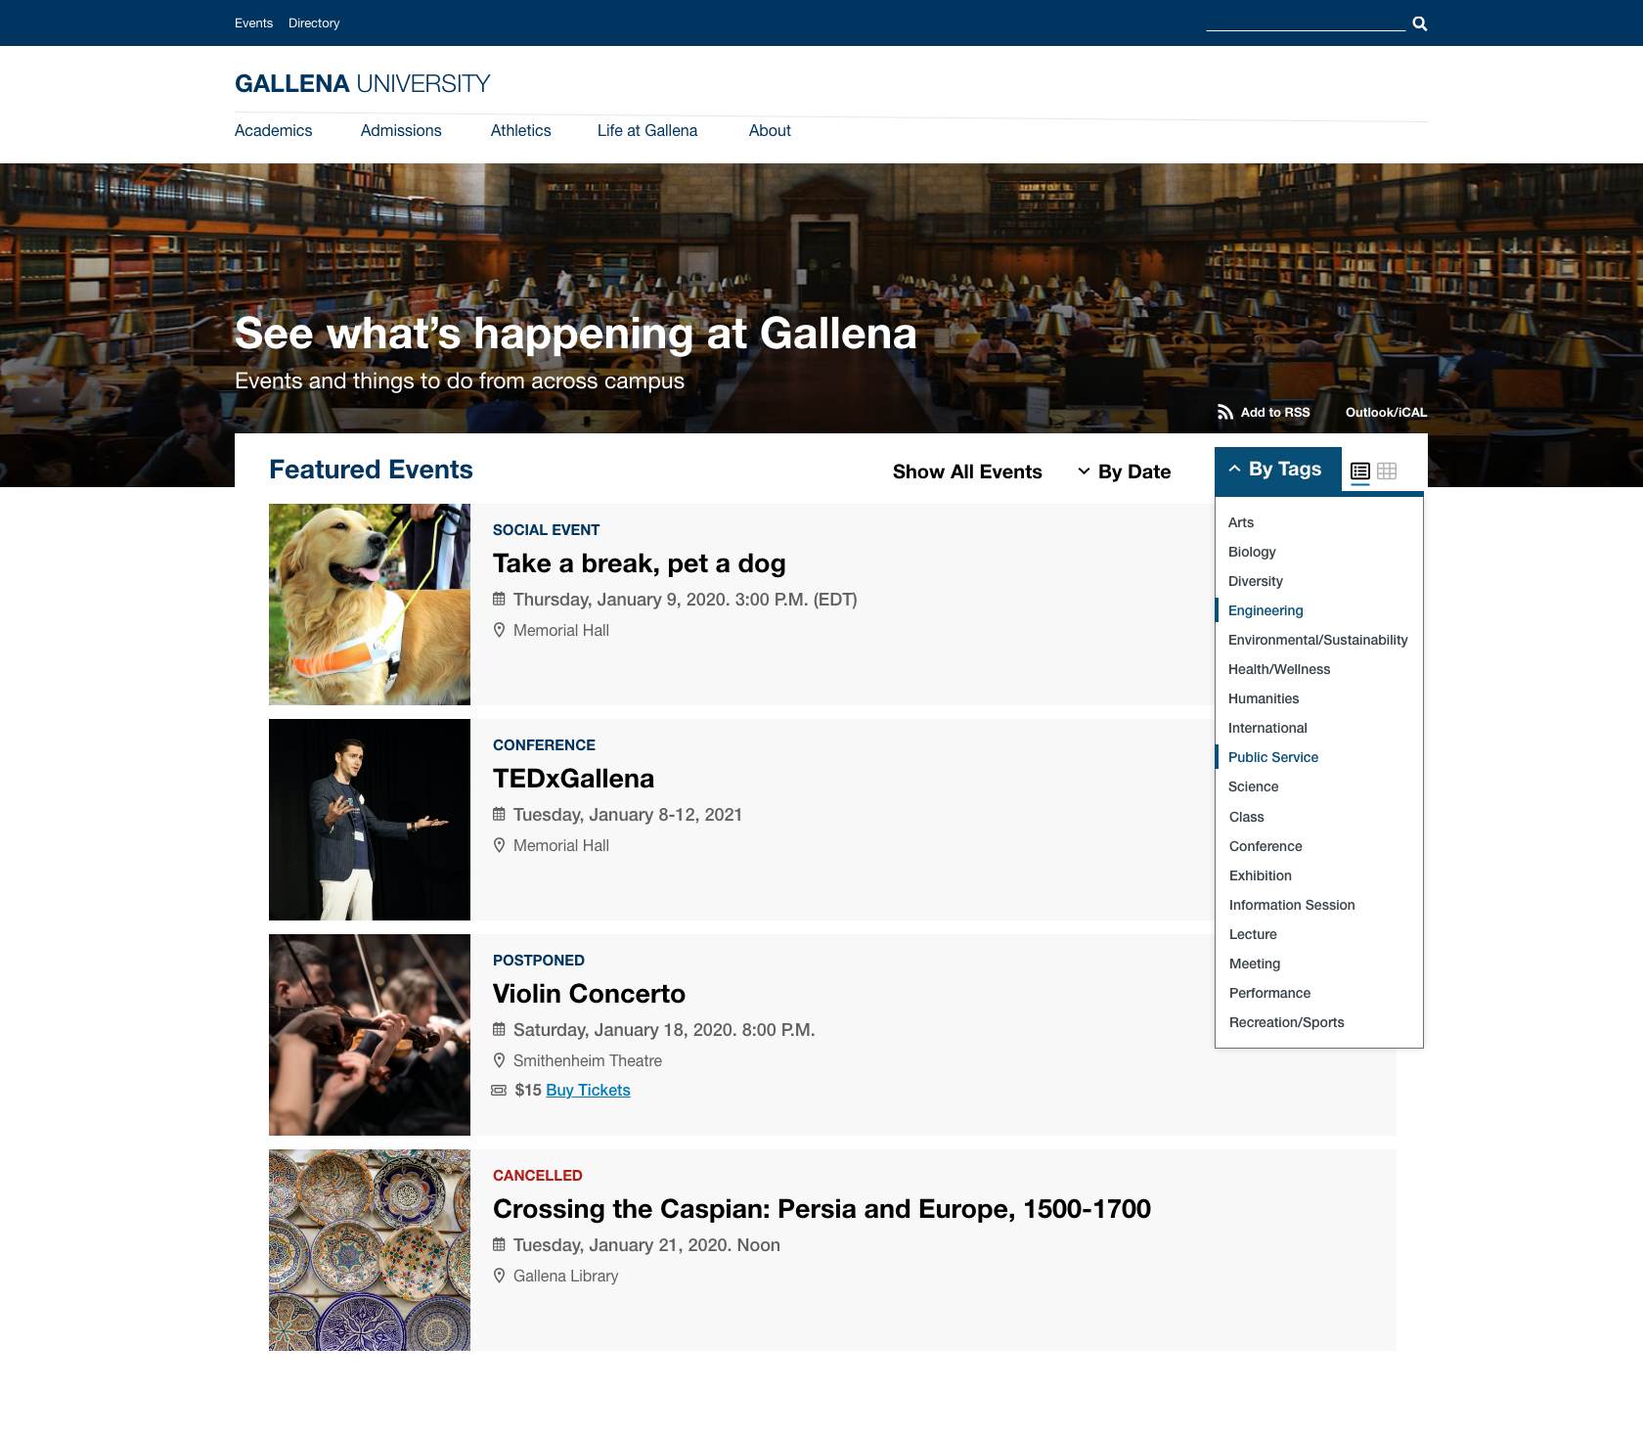
Calendar
Display
Events to engage website visitors
Multiple Views and Filters
Implement
Out of box Calendar themes
Styles to match customer’s brand
Build custom design
Leverage
Workflows, Access controls
Existing tagging mechanisms
Avoid
Duplicate user maintenance
Governance structures
Integrate
Instinct Personalization by Modern Campus

Slide 5
Let’s Dive In!

Slide 6
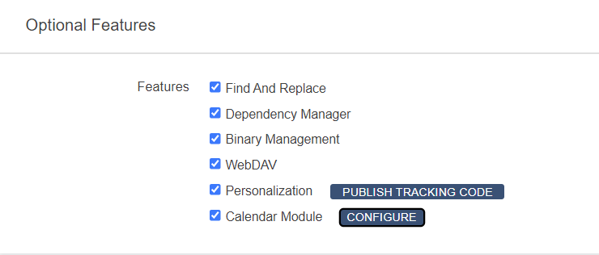
Enable Calendar on your Site
Go to Setup > Sites > Optional Features.
Select the checkbox for Calendar Module.
Click Configure.
Select the checkboxes to
Show event locations and/or event organizers (attributes) on your public calendar and,
Allow content editors to add or delete locations and/or organizers
In the Calendar configuration box, click Save.
In the Site Settings page, click Save

Slide 7
Setup Calendar
Level 9 & 10 admins can define Calendar Appearance settings : Go to Add-Ons > Calendar > Settings.
Enter Title and Sub-title for your public events page (Mandatory)
Set time zone for events on your public events page (Mandatory)
Set below optional fields to help you define appearance for your calendar :
Enter Time zone (Example - PST or Pacific)
Header Image & Alt Text
Default View
Default Events
Theme Color
Google Maps API (To show maps on event details page)
Enable tracking to leverage personalize content
Click Save.

Slide 8
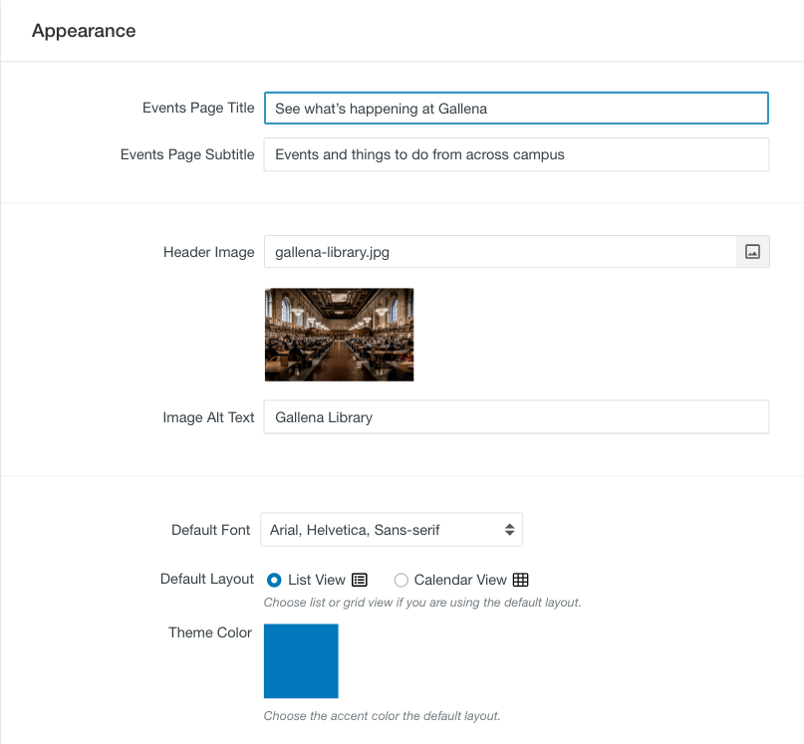
Setup Calendar
Title & Subtitle
Color
Default View
Header Image
Font

Slide 9
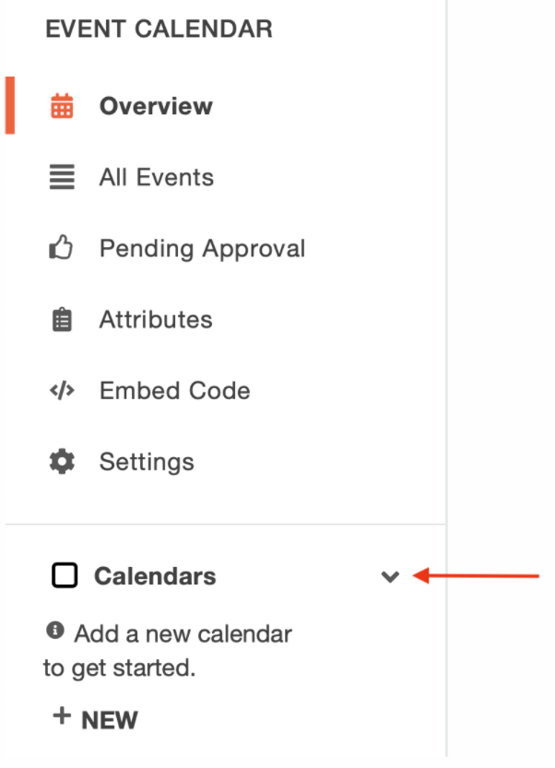
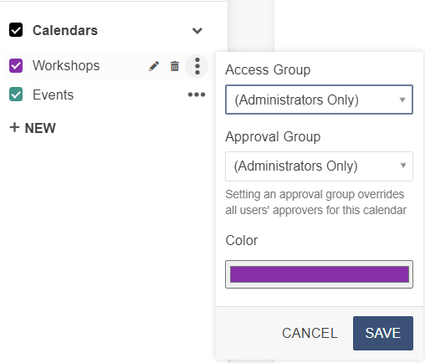
Add Calendar
Create as many individual calendars as you need.
Create individual calendars as follows:
In the Event Calendar panel, click to expand Calendars.
Click New Calendar.
Type to enter calendar name.
Set Access and Approval Groups for each calendar
Users in access group can send approval requests.
Users in approval group can approve events specific to calendar.

Slide 10
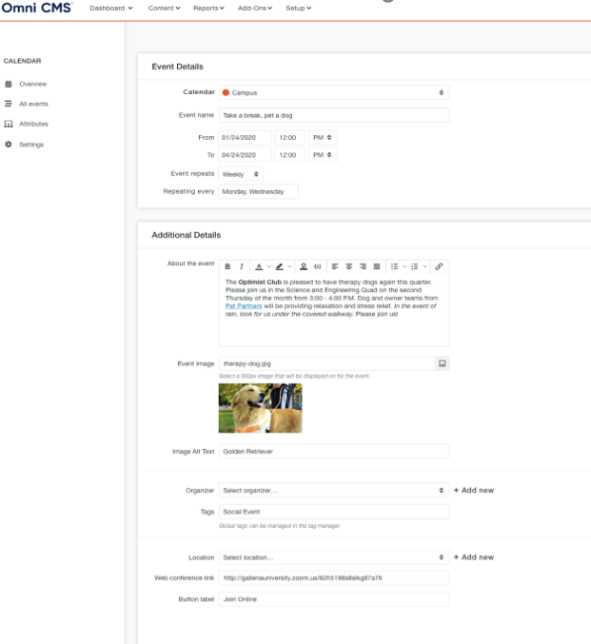
Create & Publish Events
Create Events
Calendar > All Events > Click +New Event.
Select Calendar that will show your event
Enter the following :
Name
Date/Time
Set Recurring & its recurrence details
Image
Select Organizer
Select Location
Publish Events
Calendar > Pending Approval
List of all events pending to be approved will be displayed.
Review the event detail
Publish

Slide 11
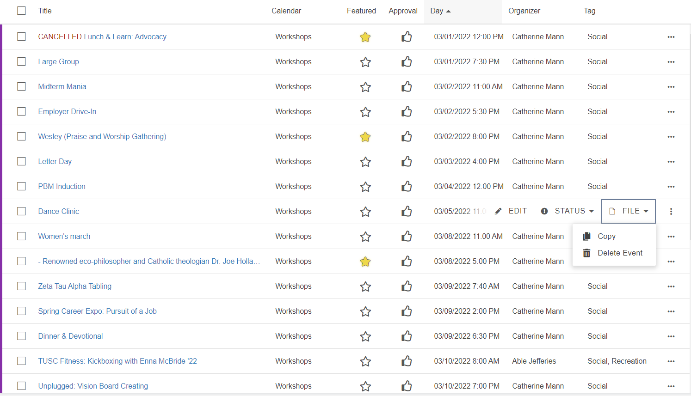
Event Actions
Edit Event :
To edit an event, go to Calendar > All Events and click the filename.
Change the event details.
Cancel or Postpone Event
To change the status of an event, go to All Events.
Click the More Actions menu for the event.
Click Status.
Click Postpone or Cancel.
Delete Event
Go to Add-Ons > Calendar > All Events.
Click the More Actions menu for the event.
Click File > Delete Event.

Slide 12
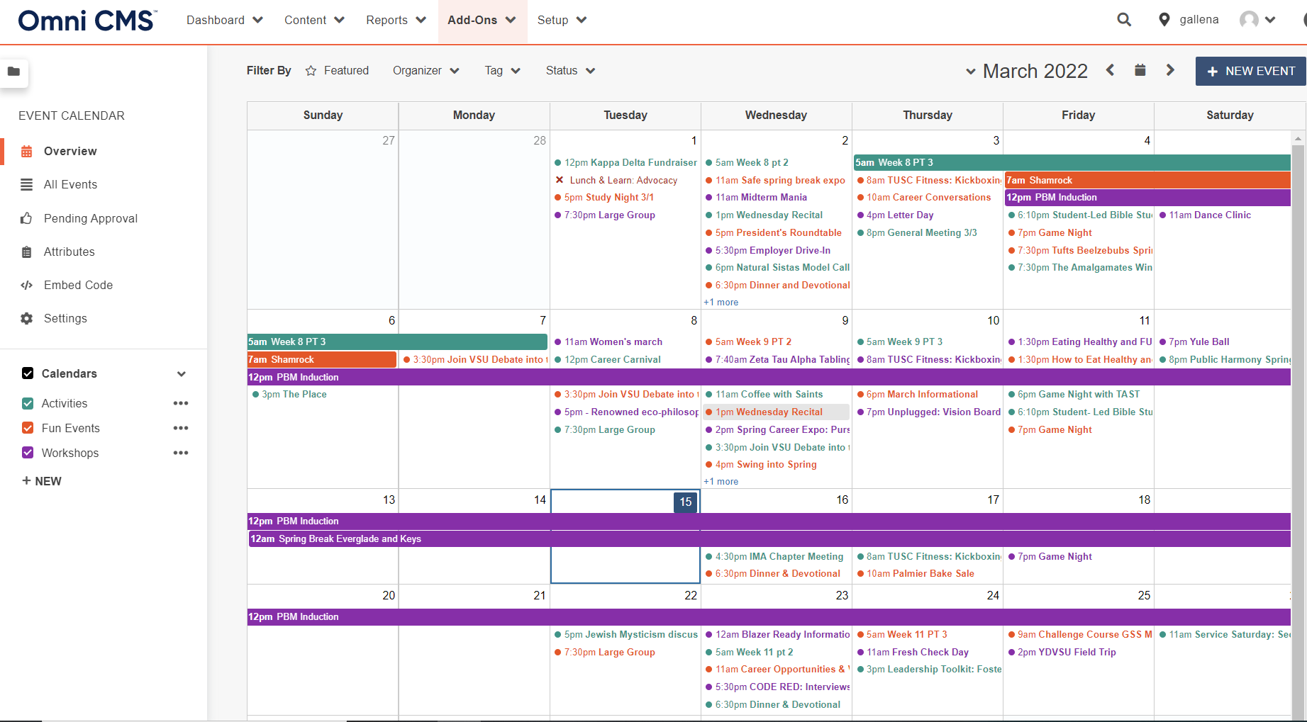
Dashboard - Overview
To view events in a grid view, go to Overview.
Provide view of all events basis months
Filter by Featured, Organizer, Tag and Calendar
Create new Calendars and assign access by group

Slide 13
Embed Calendar
Levels 9 and 10 administrators can copy the embed code for calendar(s). Then insert the calendar embed code on as many pages as you like, inside or outside Omni CMS
Go to Calendar > Embed Code.
Select the checkboxes to include events from specified calendars
By default, events from all current and future calendars will be included.
Click Copy Snippet.
Paste the snippet in the source code of pages.
You can also embed the calendar(s) in assets, snippets, or components.

Slide 14
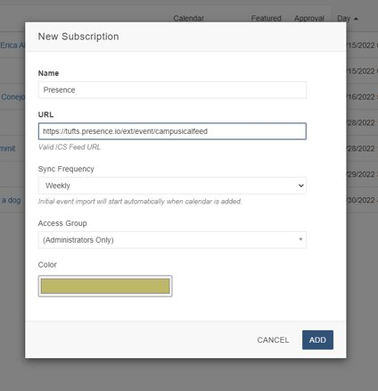
External Feed Integration
To manage events outside of Omni CMS, for example using Presence, Add subscription to show events on Omni CMS public events page.
Steps :
Go to Add-Ons > Calendar > Overview.
In the Event Calendar panel, click to expand Calendars.
Click New Subscription.
Enter subscription name.
Enter the public URL (ending in .ics) of trusted* external ICS feed.
Define Sync Frequency
Set Access and Approval Group
On click of Add, events from valid ICS feed will begin to import.

Slide 15
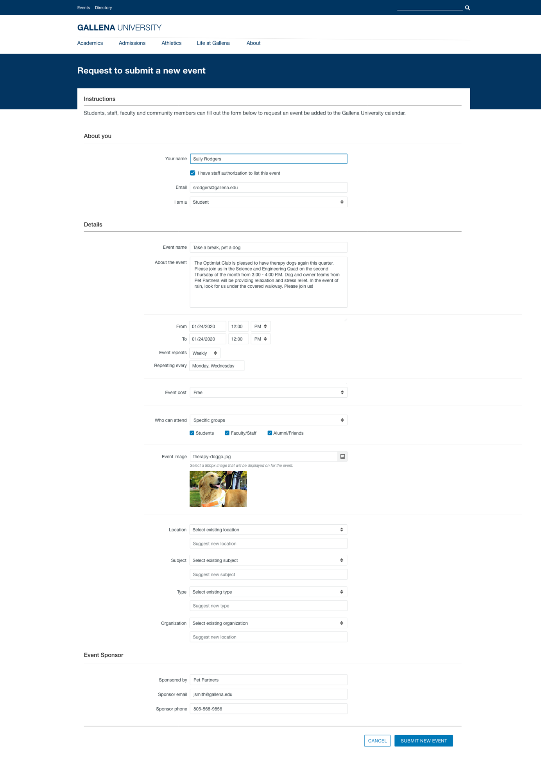
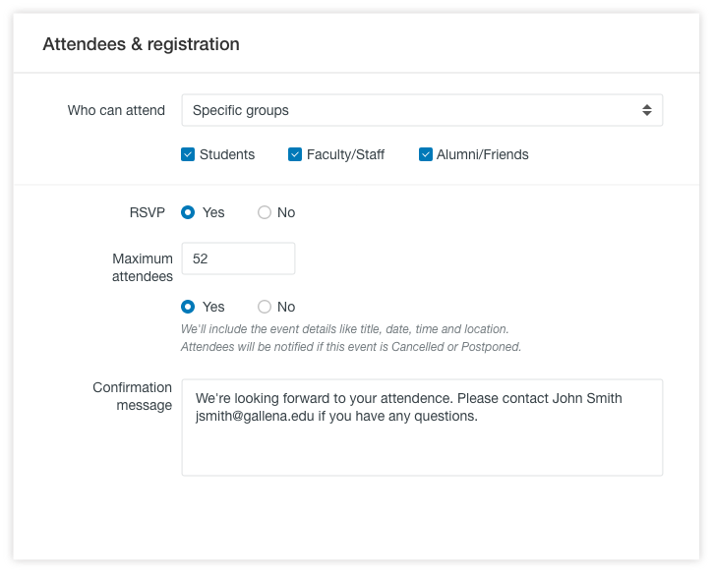
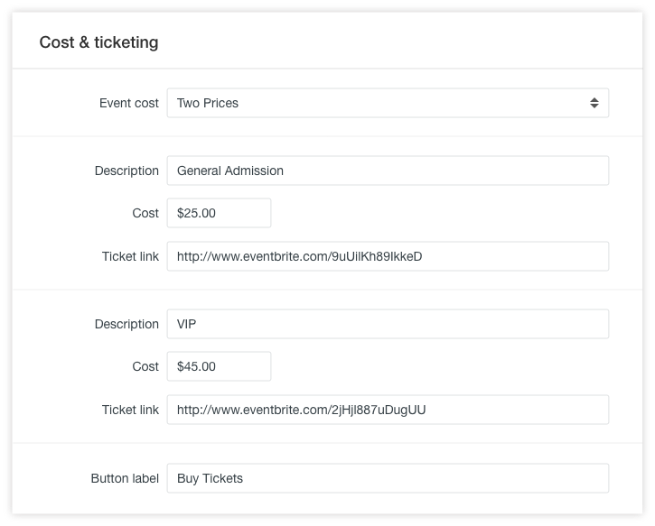
Looking Ahead (2022)
Public Submission
RSVP
Price & Event Links

Slide 16
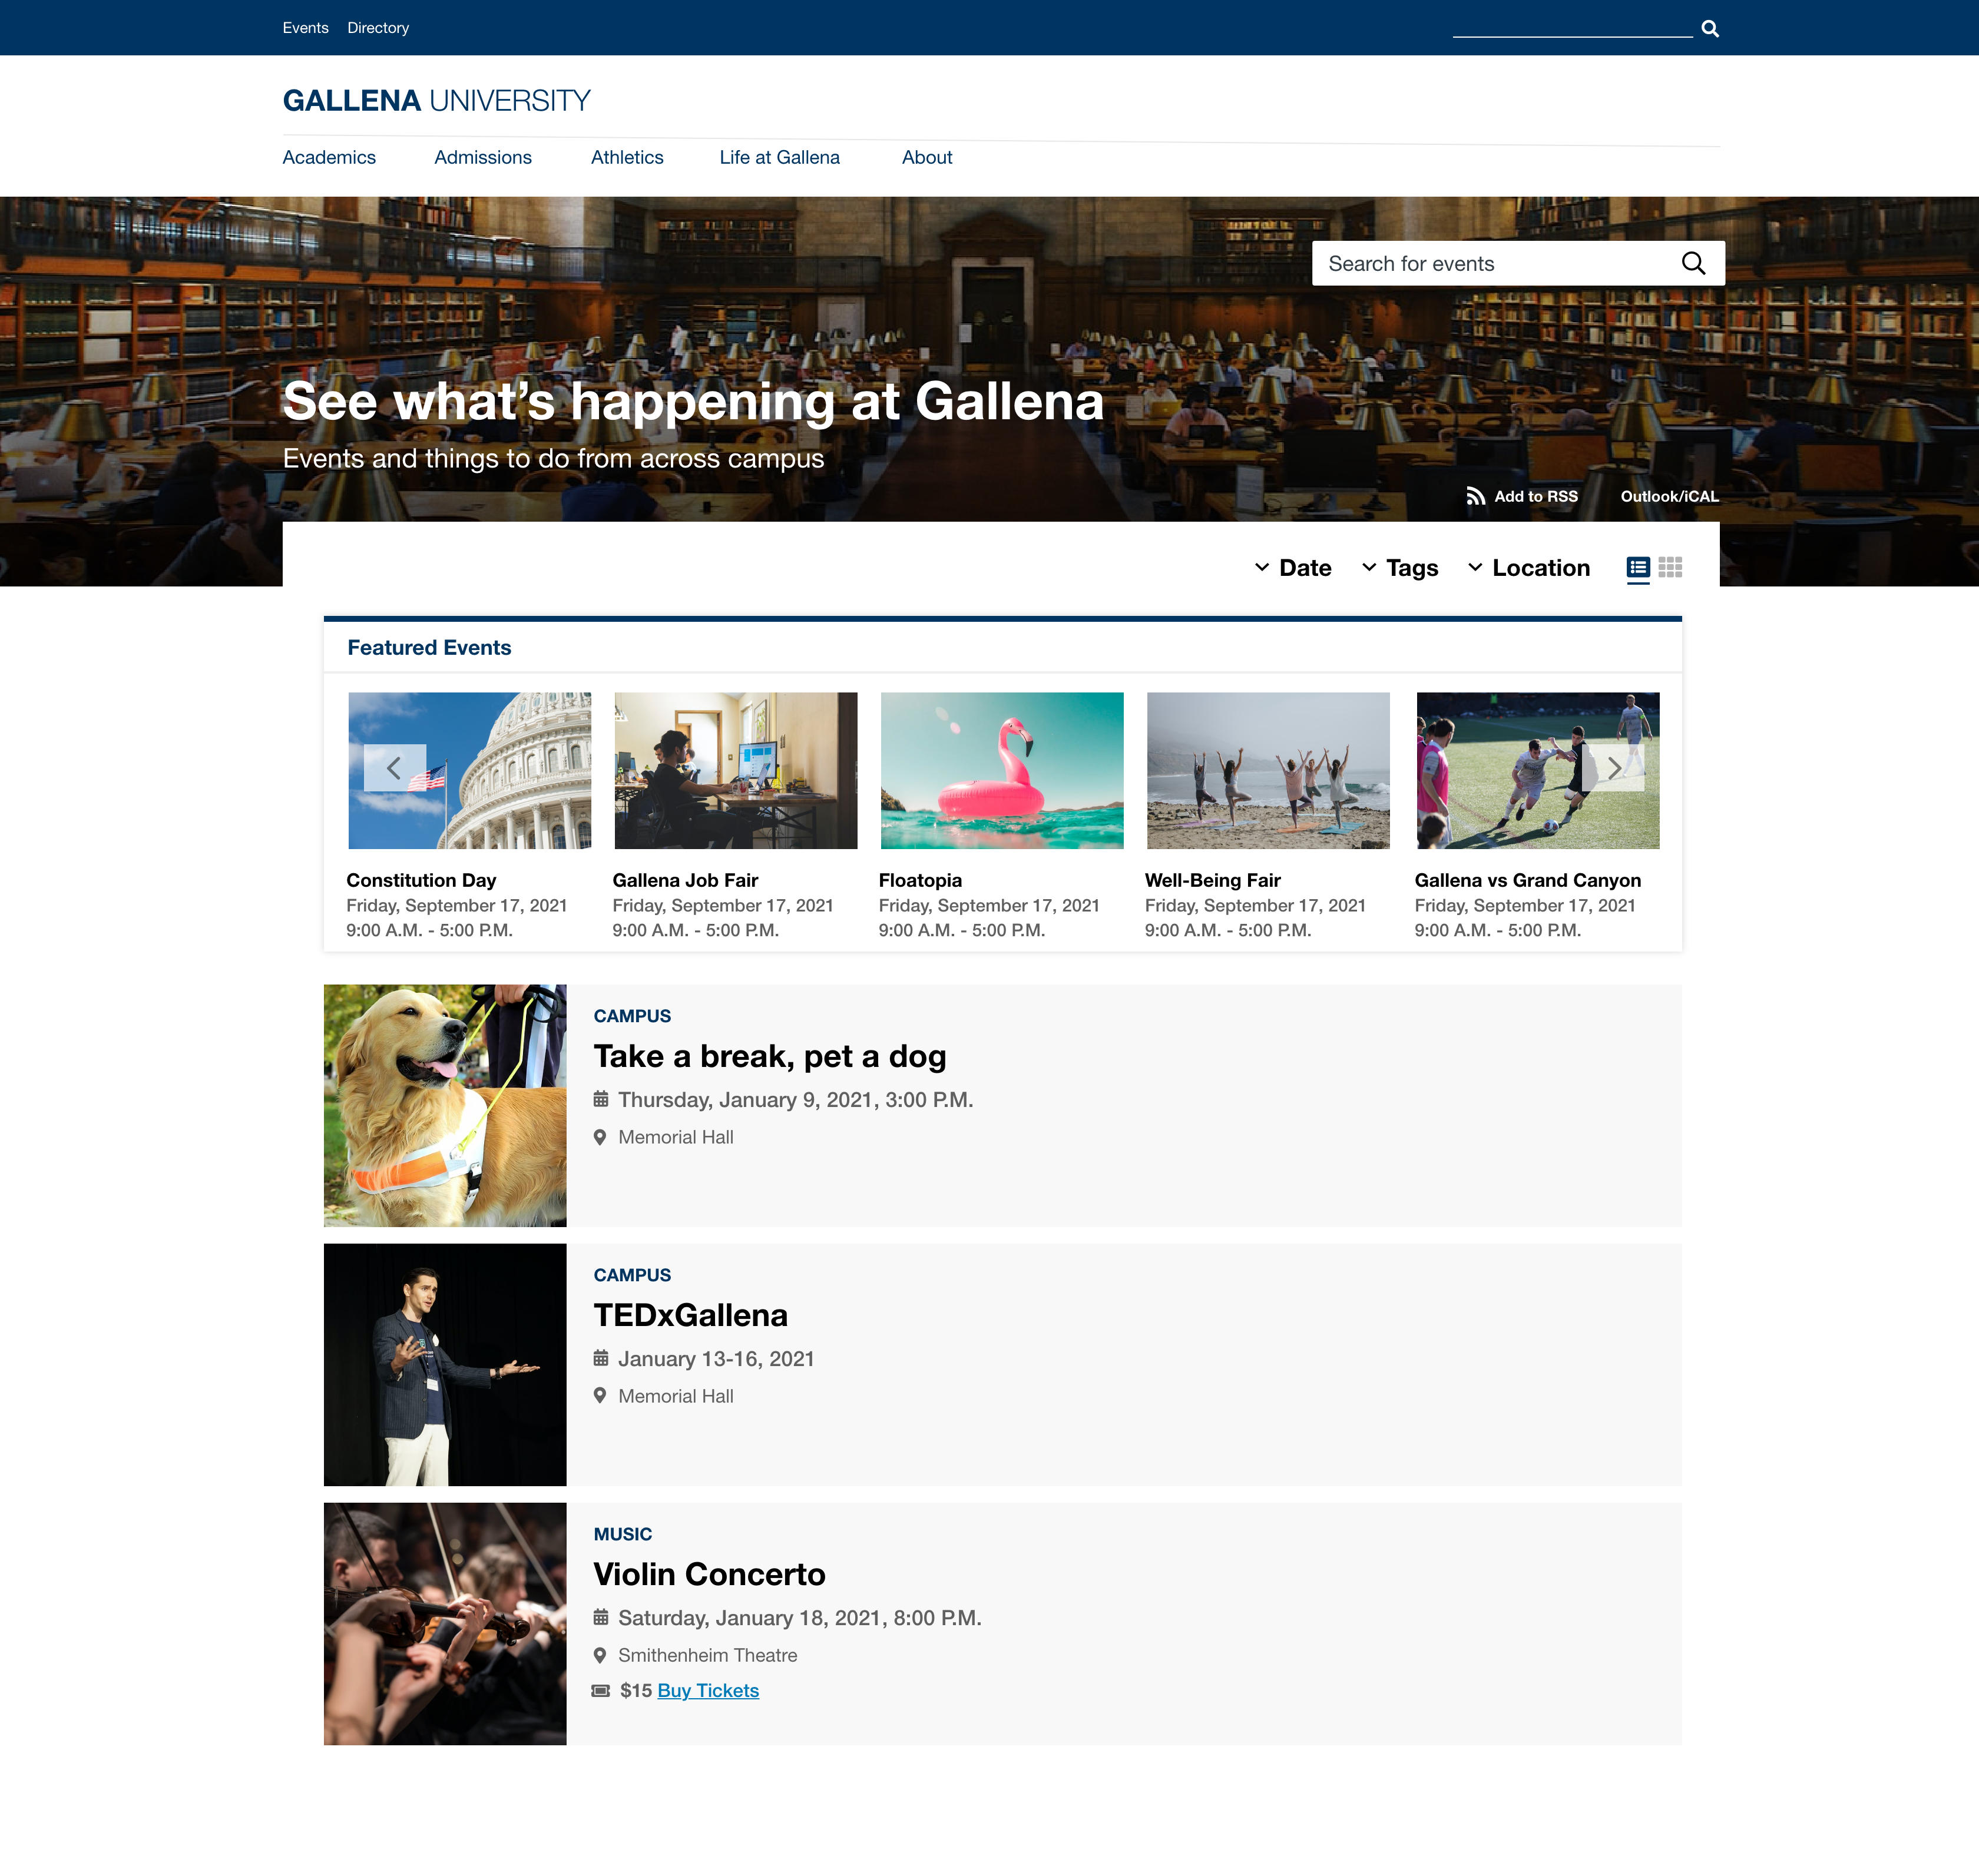
Looking Ahead (2022)
Featured : Featured events highlighted at the top

Slide 17
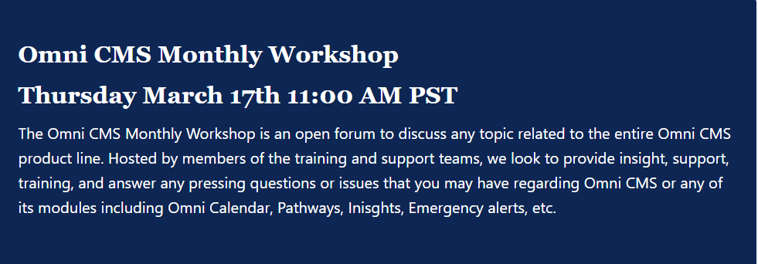
Learn More About Calendar
WORKSHOP 9th March 1:00pm EST | How to Engage Website Visitors for OMNI CMS Calendar | TEST Deepika Chhabra MODERN CAMPUS
OMNI Monthly Workshops
Register Here : https://support.moderncampus.com/

Slide 18
Q & A

Slide 19
THANK YOU!

